Slide 1

Fetch Rewards
Evaluating

Slide 2
Fetch Rewards would like to have a better idea of which products are popular
We need to address
Are bonus rewards influencing sales?
Focus on trends to predict future product sales

Slide 3
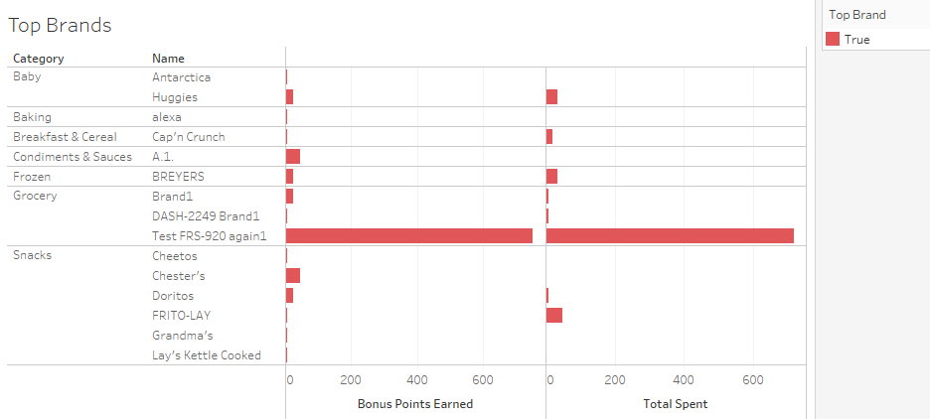
Tops Brands sales

Slide 4
Conclusions
We can see that the bonus rewards do indeed have a positive effect on product sales.
Test brand @1595531348245 is testing very well. It is a top seller among our active users.
Targeting our sales to the baking category could prove fruitful in the future judging by the sales of the “test” products.

